Slide 1


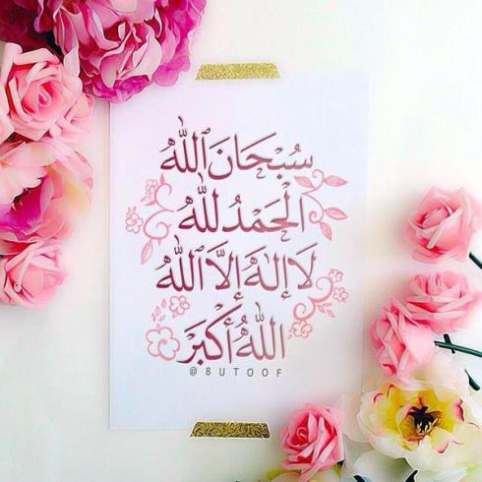

Slide 2
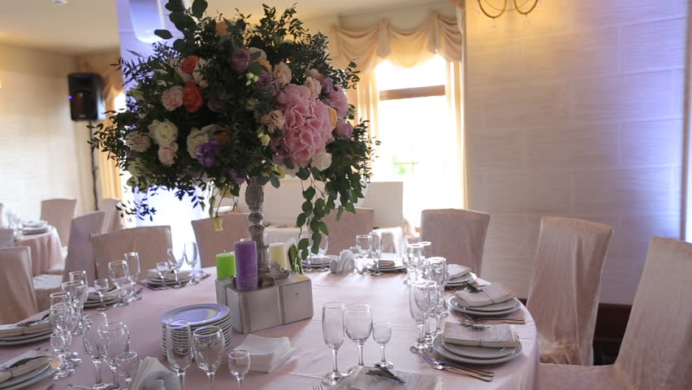
Unit 7

Slide 3

Opener

Slide 4


Write words which begin with the letter

Slide 5






thing

Slide 6
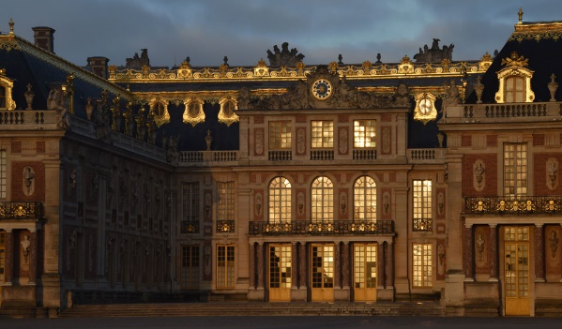

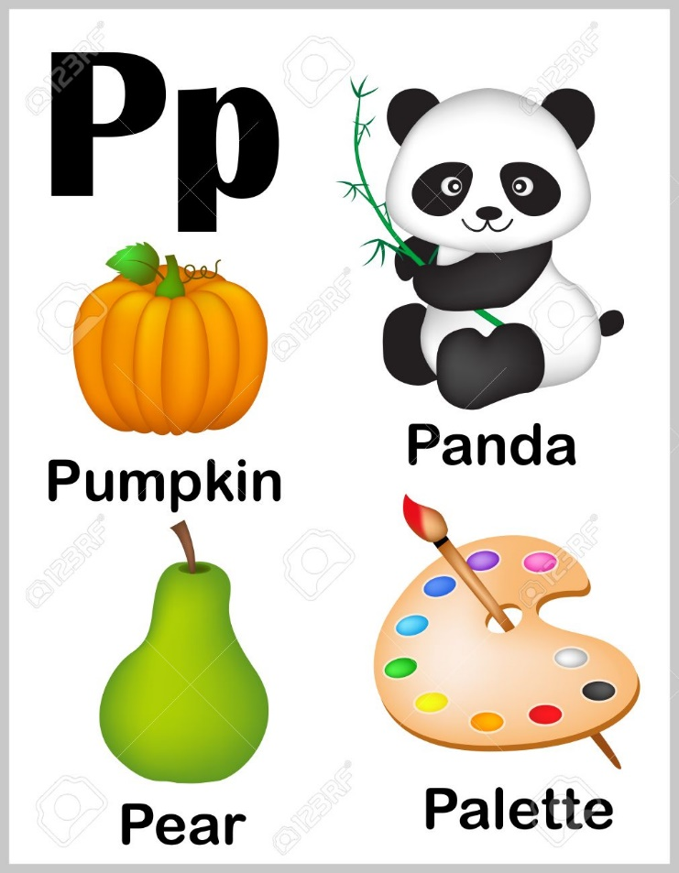


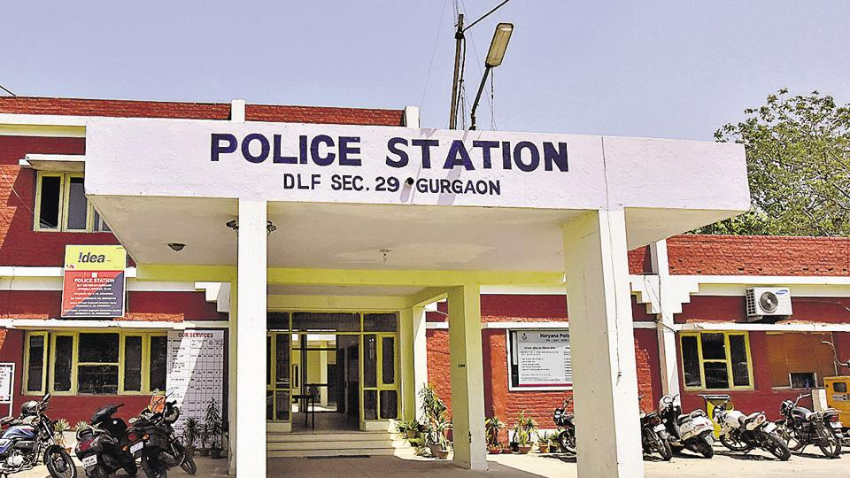





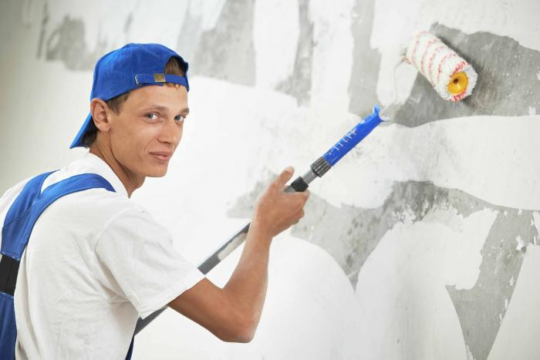

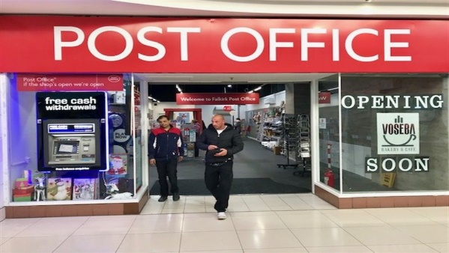
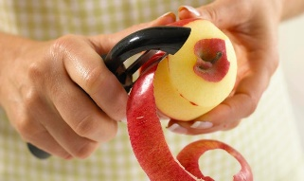
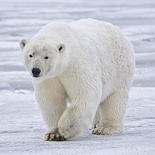






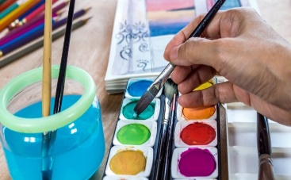
thing
photographer
palace
pray
painter
peel
policeman
paint

Slide 7

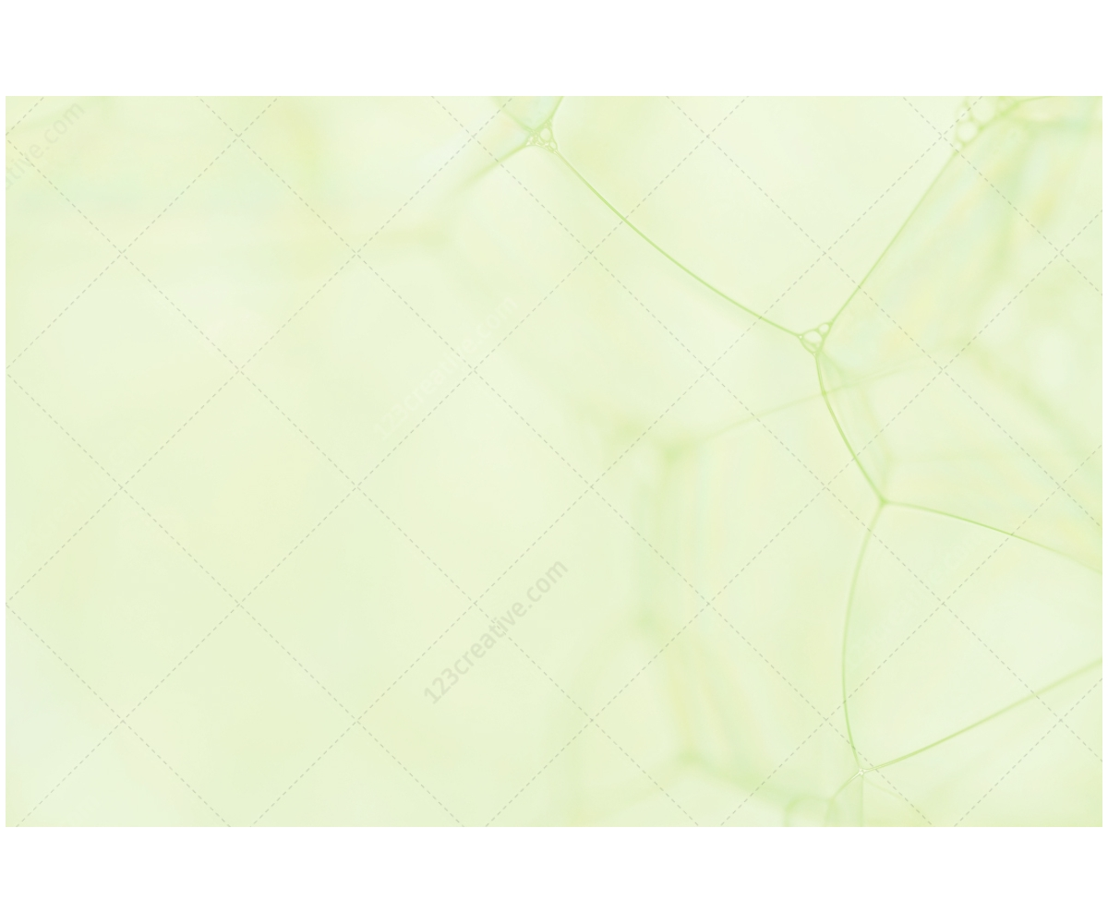
GAME TIME!
“Look at the letters
&
Guess the word”

Slide 8


Slide 9
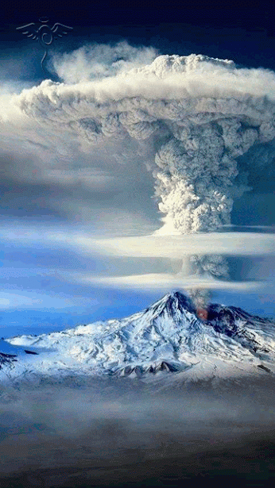
Student’s Book
Page 62

Slide 10

Group work

Slide 11

Check your answers.

Slide 12




Slide 13
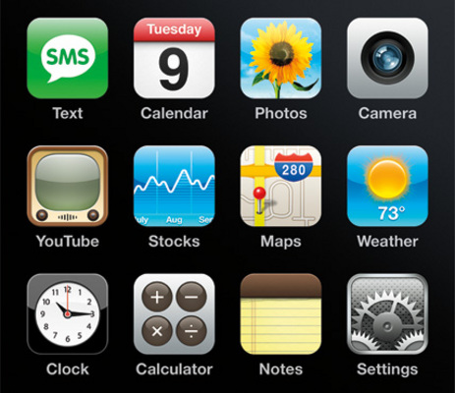
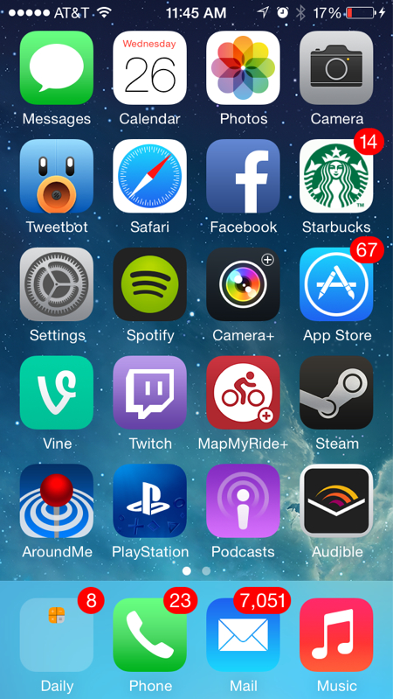
Mention some applications on smart phones.

Slide 14
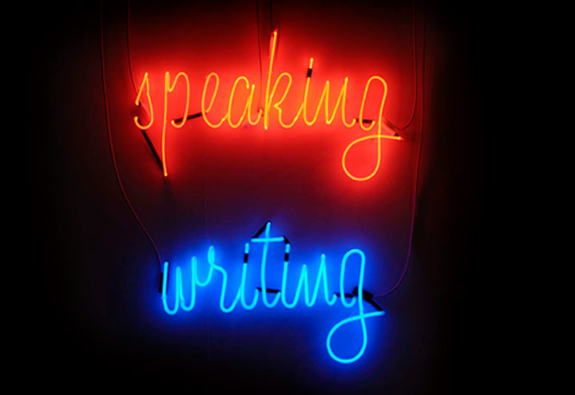

Slide 15


a. What smartphone application should everybody use?
Discuss and fill in the spider-gram with reasons to support your choice.
Share your ideas with other groups.

Slide 16


Slide 17
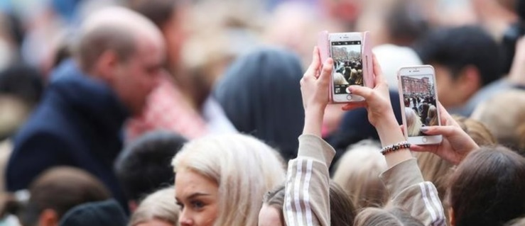
Read your answers.

Slide 18

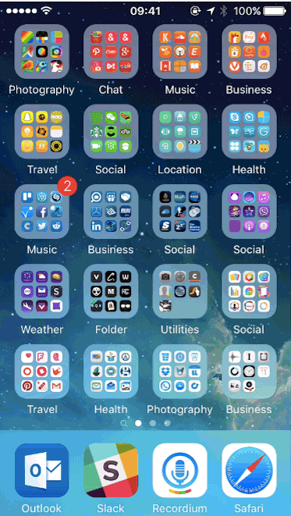
b. In your notebook, develop your notes into a two-paragraph report expressing your opinion about this application by discussing its features and benefits.

Slide 19

Checklist:
Did I begin my report by stating the topic and my opinion?
Did I use facts and details to support my opinions?
Did I conclude by telling my opinion in different words?

Slide 20

Read your reports.

Slide 21

Closure

Slide 22
Imagine you work for a mobile phone company. Design a mobile phone of the future.
Think about the features it has and what it can do. Draw the phone and mention all the features.
Present your idea to the class.

Slide 23

Thank you

